Slide 1

DATA ANALYSIS - OLIST STORE ANALYSIS

Slide 2
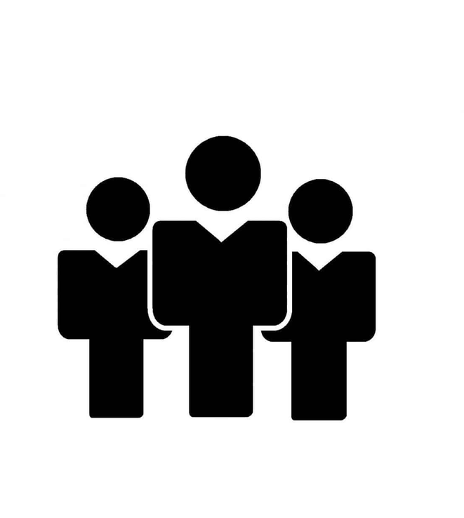
OUR TEAM
Esha Shirsat
Mufida Khan
Siddhant Gaikwad
Samad Sultan Khatri

Slide 3
INDEX
Background – Client scenario & data overview
Database Normalization
ETL process optimization
Analytics insights Automation – Benefits and Procedure
Dashboard Demo

Slide 4
INTRODUCTION
The project assesses the store's sales performance by examining key metrics like revenue growth, average transaction value, conversion rates, and customer retention.
The project evaluates the impact of the store on customer experience and satisfaction.By understanding customer preferences, the project helps optimize the store's offerings to enhance the overall experience.
The project analyzes the different payment modes accepted by the store. By examining customer payment habits, the project seeks to identify the preferred payment modes among the target audience.
Through the analysis of operational efficiency, inventory management, and cost control measures, the project aims to streamline operations and reduce expenses.
The project assesses the store's operational efficiency by analyzing aspects such as inventory management, supply chain logistics, staff productivity, and cost control measures.

Slide 5
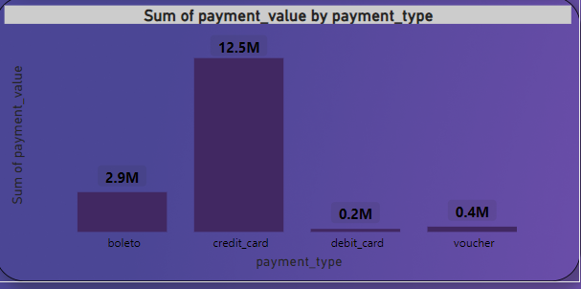
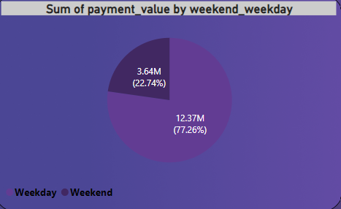
KPI 1
Total payment has been dropping, with weekends having the fewest orders. This indicates that Saturdays and Sundays are less active and have fewer purchases than weekdays.
Based on the data above, it is best to concentrate on growing weekend sales by capturing customers' attention and persuading them to buy more on Saturdays and Sundays.

Slide 6
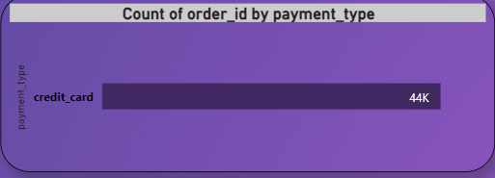
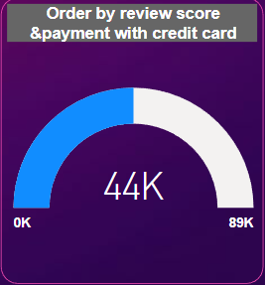
KPI 2
Most customers are preferring credit card as payment type. Total payment value received is maximum from payment type credit card i.e. nearly 78% of total payment
Nearly 57% orders are for products with review score 5. We have to improve quality of products so that customer review score will increase and therefore number of orders will also increase

Slide 7
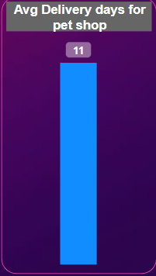
KPI 3
Average number of days to deliver the order for pet shop is 11 days.
A smaller average number of days suggests a more rapid and efficient order delivery process.
A larger average number of days, on the other hand, indicates delays or inefficiencies in the order fulfilment process.
Identifying and addressing the reasons that cause delays is critical for improving customer experience and maintaining a competitive edge in the market.

Slide 8
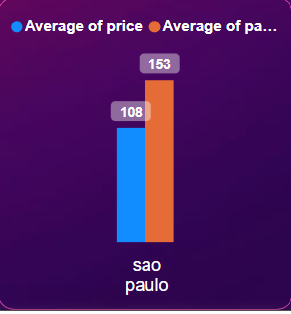
KPI 4
Average Payment is higher than average price in Sao Paulo City.
Where average payment is 153 and average price is 108.
Based on the information supplied, if demand for items in Sao Paulo city has stayed stable despite modest price fluctuations in the past, demand is anticipated to increase in the coming year as well.

Slide 9
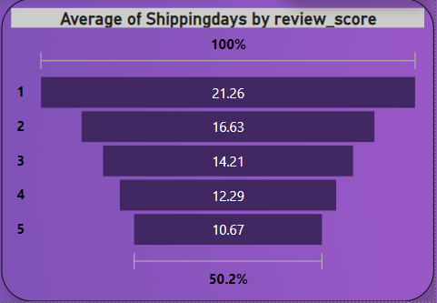
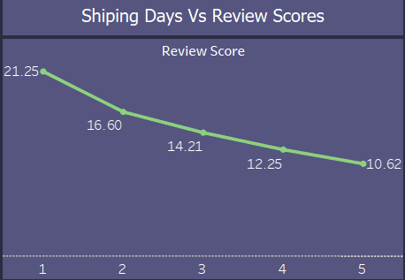
KPI 5
This KPI examines the association between review scores and shipping time.
This shows that the overall delivery procedure is highly efficient, with the majority of consumers receiving their items ahead of schedule.
Analysing and resolving the underlying problems can aid in decreasing shipment times and increasing order volumes in certain places.

Slide 10
CONCLUSION
1st KPI :- Customer behavior and preferences can be gained by analyzing payment statistics based on weekdays and weekends.
2nd KPI :- Customer satisfaction and preferred payment methods are indicated by the number of orders with reviews of five stars and credit card payments. It implies that customers are more likely to leave favorable evaluations when they pay with a credit card.
3rd KPI :- Customers of pet stores can learn about the effectiveness and speed of the delivery process by looking at the typical number of days it takes to fulfil their orders. It can be used to assess the efficiency of the delivery and logistics teams, spot bottlenecks, and raise client satisfaction.
4th KPI :- The purchasing power and spending habits of this particular client niche can be better understood by looking at the average pricing and payment values from customers in So Paulo city. It can be applied to targeted marketing plans and selection of product prices.
5th KPI :- In order to optimise the delivery process and raise customer happiness, it can be used to determine whether faster or slower shipping affects consumer perception and review scores.

Slide 11
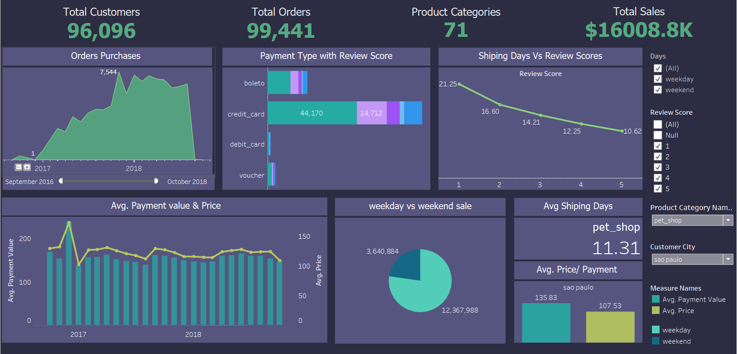
TABLEAU DASHBOARD

Slide 12
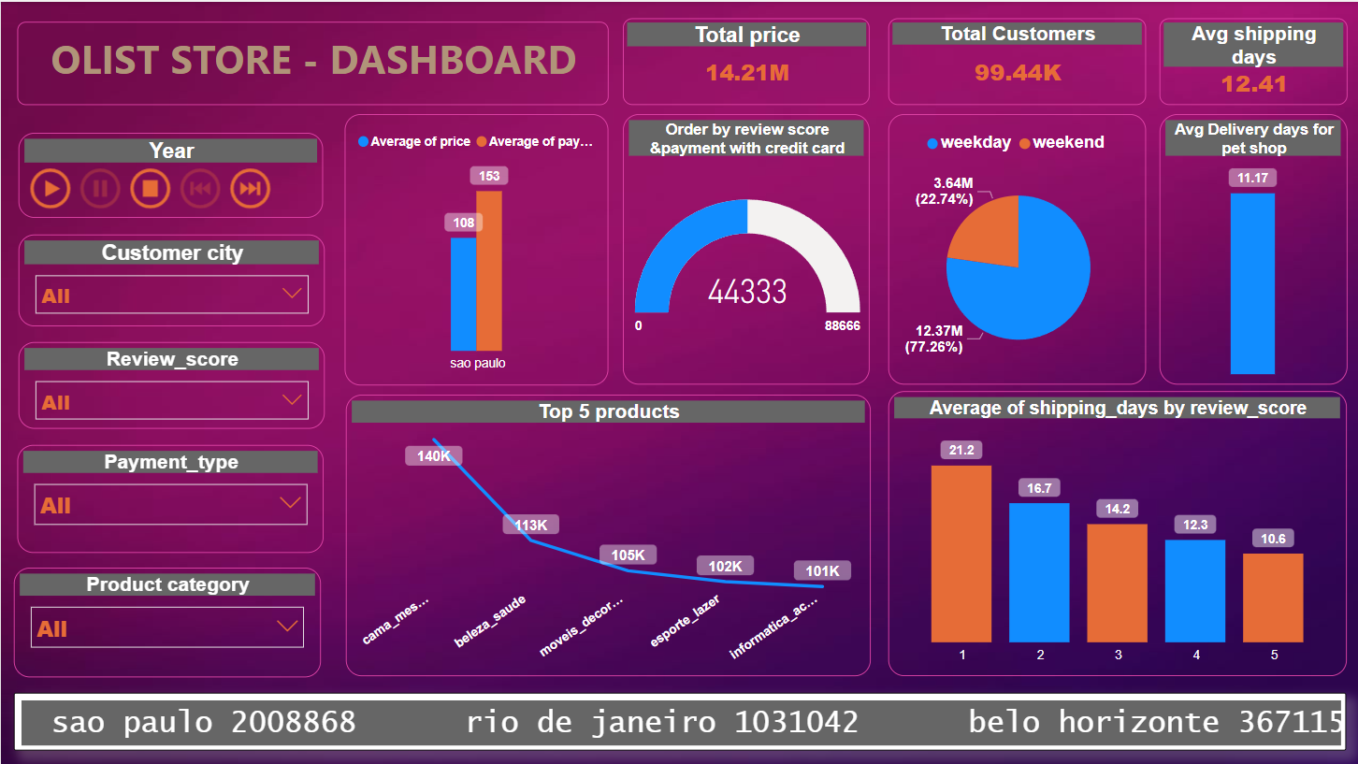
POWER BI DASHBOARD

Slide 13
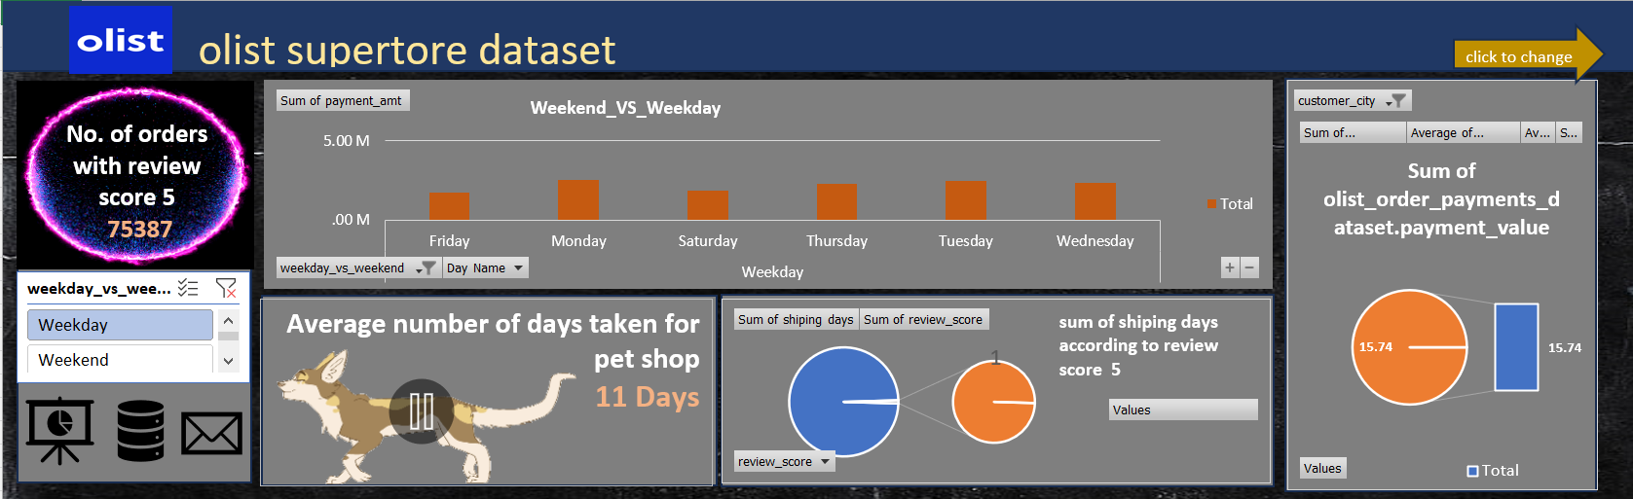
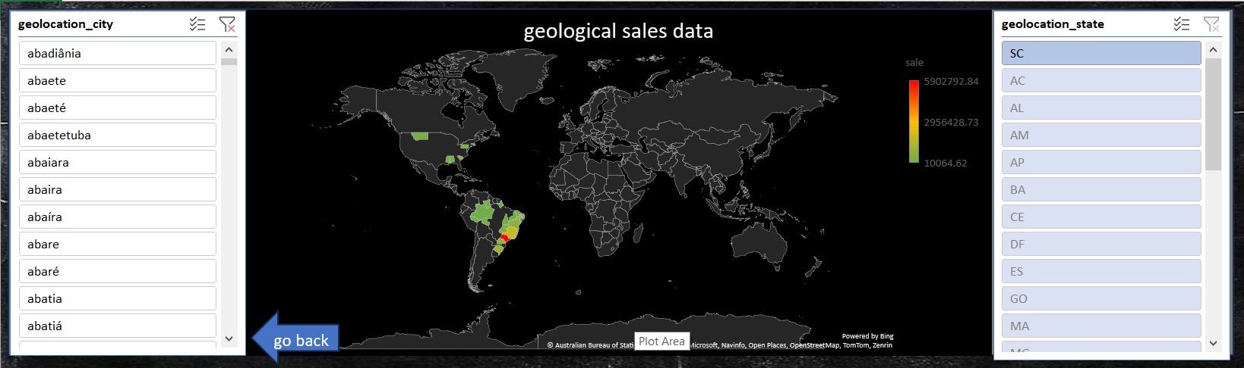
EXCEL DASHBOARD

Slide 14


